Slide 1



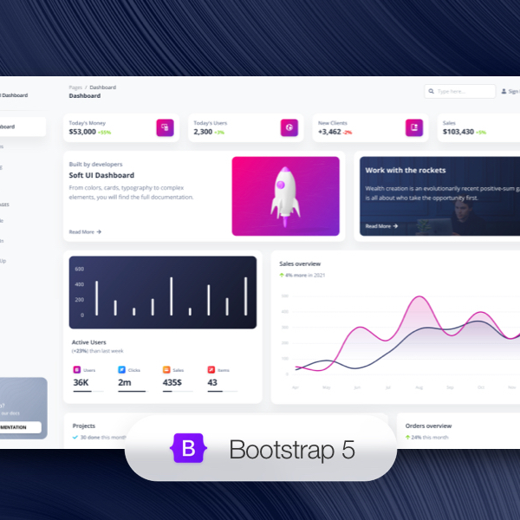

Diversity Hackathon Career Friendly Application
Team No. : 19
Team Contribution
FRONTEND DEVELOPMENT
BACKEND DEVELOPMENT
AI/ML/PPT
GitHub Link
Yasaswini Srisatya Lakshmi
Sahithi Jakki Reddy
Priya Kumari
Mansi
Divyanshi Garg
https://github.com/DG121018/SC-Diversity-Hackathon

